Slide 1
Mental Health Inquiry
Mental Health Australia, 31 October 2019
Stephen King, Commissioner
Julie Abramson, Commissioner

Slide 2

Why a PC inquiry?
Problems and solutions lie beyond the clinical areas
Multiple governments required
Magnitude of costs for Australia
… and the potential benefits

Slide 3
What will be covered?
Process
Findings
Recommendations
Next steps

Slide 4



Timeline
31 Oct 2019
Draft Report
Draft
23 May 2020
Final Report to Government
7 Oct 2018
Jan 2019
Government announces inquiry
23 Nov 2018
PC releases issues paper
5 April 2019
23 Jan 2020
Treasurer sends reference to Commission
Initial submissions due
Final submissions due
PC visits interested parties, invites submissions & comments
Nov 2019 to Feb 2020
Public hearings and further consultation
Process

Slide 5
Consultations
564
191
Submissions
Online comments
Process

Slide 6
Consultations
Visited
Upcoming visits
Process

Slide 7
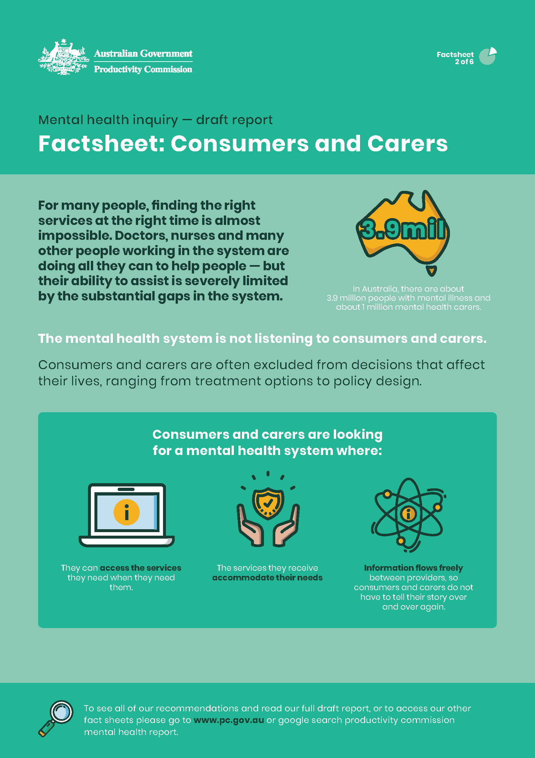
Factsheets

Slide 8
Mental illness affects people differently
Findings

Slide 9
What is the prevalence of mental illness?
Mental illness is often prevalent early in life ...
... and tends to decline with age
Findings
Source: Institute for Health Metrics and Evaluation (Global Health Data Exchange, GBD Results Tool).

Slide 10
Prevalence differs by characteristics
Findings

Slide 11
Suicide and mental illness
Almost two-thirds of people who die by suicide had a diagnosed mental illness …
… and two-thirds had an associated psychosocial risk factor, such as divorce.
Findings
Source: ABS (2018, 2019b).

Slide 12
Intentional self-harm accounts for the highest number of years of potential life lost
Findings

Slide 13
Suicide rates tend to be higher in regional areas
Age-standardised suicide rate per 100 000 people, 2018
Findings

Slide 14
Mental health related service use is lower in regional and remote areas
Findings

Slide 15
What is the cost of mental ill-health?
$43 to $51 billion
Direct expenditure
$18 billion
Healthcare and other supports
(such as housing, education, justice)
$10 to $18 billion
Lost productivity
(lower employment, absenteeism and presenteeism)
$15 billion
Informal care
(provided by family and friends)
$130 billion
Diminished health and reduced life expectancy
Findings

Slide 16
Reform areas
Close critical gaps in healthcare services
Investment in services beyond health
Prevention & early intervention
Getting people into work and helping them to remain there
Care navigation, coordination, governance and funding
Reform areas

Slide 17
1. Close critical gaps in healthcare services…
… what problems are we addressing?
Treatment tacked onto systems designed around physical illness
Too often, the views/preferences of consumers and their carers get ignored
Services are often unconnected, lacking clear pathways and communication between healthcare providers
Significant service gaps for some
  GPs – as gateways and gatekeepers – too often lack mental health knowledge
  face-to-face psychological therapy consistent with treatment needs
  specialised mental healthcare professionals in regional and remote areas
  alternatives to hospital EDs for people in crisis or needing after-hours care
  community bed-based services as alternative to acute inpatient services
  child and adolescent mental healthcare services
Reform area 1

Slide 18
1. Improving mental healthcare
Start now
Start later
Expand clinician-supported online treatment options
Provision of acute & non-acute beds & ambulatory services that reflect regionally assessed needs
Improve the ED experience & provide alternatives
Mental health expertise as support to police & paramedics
Provision of child & adolescent mental health beds separate to adults
Navigation platform for mental health referral pathways
Care coordinators for consumers with the most complex care needs
Expand mental health nurse workforce
Widen access to psychological therapy & psychiatric assessment by video
Rigorous evaluation of Better Access
Expanded online portal for consumers, with timely & linked-up referral processes
Access to face-to-face psychological therapy at a level commensurate with treatment needs
Strengthen the peer workforce
Incentivise family-focused & carer-inclusive care
Incentivise psychiatric advice to GPs
Single care plan with electronic sharing of information
Recommendations

Slide 19
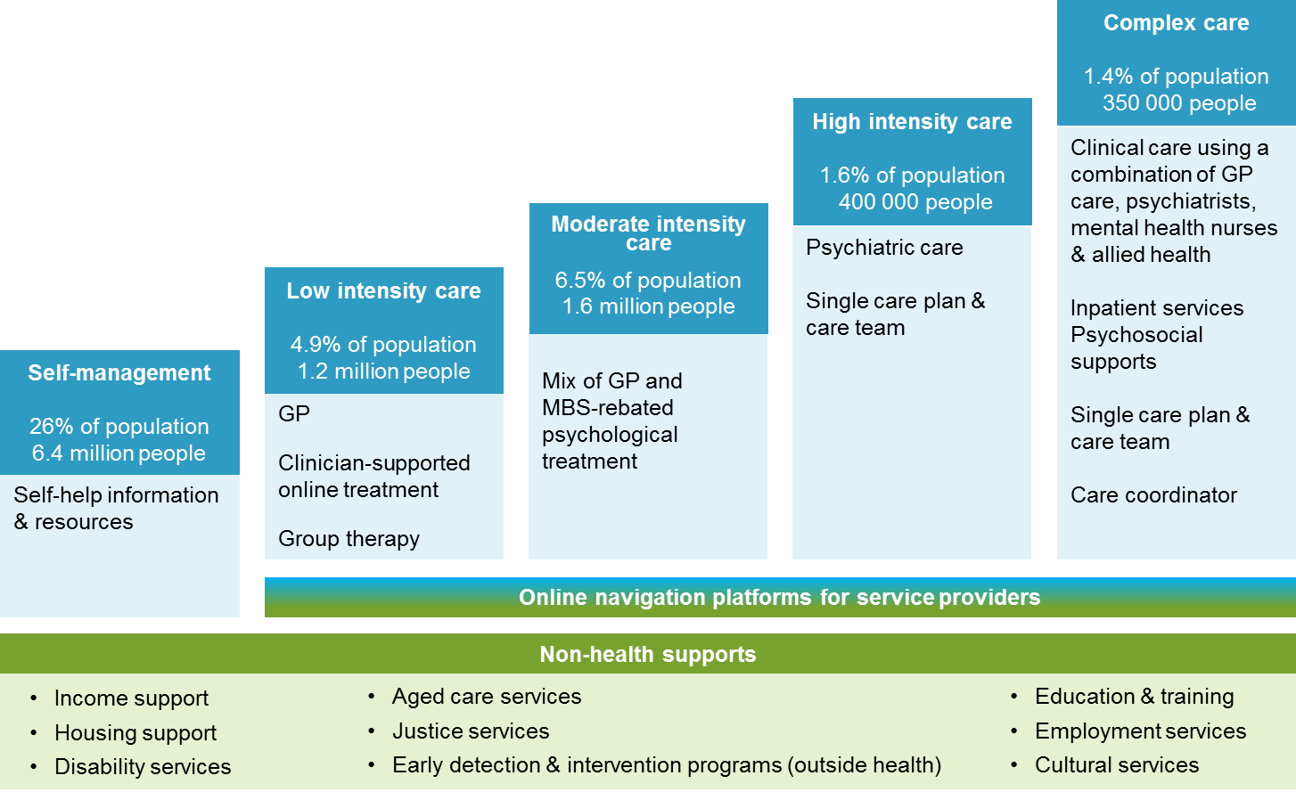
Stepped model of care
Recommendations

Slide 20
1. Improving mental healthcare
Start now
Start later
Expand clinician-supported online treatment options
Provision of acute & non-acute beds & ambulatory services that reflect regionally assessed needs
Improve the ED experience & provide alternatives
Mental health expertise as support to police & paramedics
Provision of child & adolescent mental health beds separate to adults
Navigation platform for mental health referral pathways
Care coordinators for consumers with the most complex care needs
Expand mental health nurse workforce
Widen access to psychological therapy & psychiatric assessment by video
Rigorous evaluation of Better Access
Expanded online portal for consumers, with timely & linked-up referral processes
Access to face-to-face psychological therapy at a level commensurate with treatment needs
Strengthen the peer workforce
Incentivise family-focused & carer-inclusive care
Incentivise psychiatric advice to GPs
Single care plan with electronic sharing of information
Recommendations

Slide 21
1. Improving mental healthcare
Start now
Start later
Expand clinician-supported online treatment options
Provision of acute & non-acute beds & ambulatory services that reflect regionally assessed needs
Improve the ED experience & provide alternatives
Mental health expertise as support to police & paramedics
Provision of child & adolescent mental health beds separate to adults
Navigation platform for mental health referral pathways
Care coordinators for consumers with the most complex care needs
Expand mental health nurse workforce
Widen access to psychological therapy & psychiatric assessment by video
Rigorous evaluation of Better Access
Expanded online portal for consumers, with timely & linked-up referral processes
Access to face-to-face psychological therapy at a level commensurate with treatment needs
Strengthen the peer workforce
Incentivise family-focused & carer-inclusive care
Incentivise psychiatric advice to GPs
Single care plan with electronic sharing of information
Recommendations

Slide 22
1. Improving mental healthcare
Start now
Start later
Expand clinician-supported online treatment options
Provision of acute & non-acute beds & ambulatory services that reflect regionally assessed needs
Improve the ED experience & provide alternatives
Mental health expertise as support to police & paramedics
Provision of child & adolescent mental health beds separate to adults
Navigation platform for mental health referral pathways
Care coordinators for consumers with the most complex care needs
Expand mental health nurse workforce
Widen access to psychological therapy & psychiatric assessment by video
Rigorous evaluation of Better Access
Expanded online portal for consumers, with timely & linked-up referral processes
Access to face-to-face psychological therapy at a level commensurate with treatment needs
Strengthen the peer workforce
Incentivise family-focused & carer-inclusive care
Incentivise psychiatric advice to GPs
Single care plan with electronic sharing of information
Recommendations

Slide 23
Improving mental healthcare
The shortfall in State and Territory community ambulatory services
The shortfall in public non-acute mental health beds
Source: AIHW (2019) and Commission estimates using the National Mental Health Service Planning Framework.

Slide 24
1. Improving mental healthcare
Start now
Start later
Expand clinician-supported online treatment options
Provision of acute & non-acute beds & ambulatory services that reflect regionally assessed needs
Improve the ED experience & provide alternatives
Mental health expertise as support to police & paramedics
Provision of child & adolescent mental health beds separate to adults
Navigation platform for mental health referral pathways
Care coordinators for consumers with the most complex care needs
Expand mental health nurse workforce
Widen access to psychological therapy & psychiatric assessment by video
Rigorous evaluation of Better Access
Expanded online portal for consumers, with timely & linked-up referral processes
Access to face-to-face psychological therapy at a level commensurate with treatment needs
Strengthen the peer workforce
Incentivise family-focused & carer-inclusive care
Incentivise psychiatric advice to GPs
Single care plan with electronic sharing of information
Recommendations

Slide 25
Mental health beds specifically for young people, by jurisdiction, 2016‑17

Slide 26
1. Improving mental healthcare
Start now
Start later
Expand clinician-supported online treatment options
Provision of acute & non-acute beds & ambulatory services that reflect regionally assessed needs
Improve the ED experience & provide alternatives
Mental health expertise as support to police & paramedics
Provision of child & adolescent mental health beds separate to adults
Navigation platform for mental health referral pathways
Care coordinators for consumers with the most complex care needs
Expand mental health nurse workforce
Widen access to psychological therapy & psychiatric assessment by video
Rigorous evaluation of Better Access
Expanded online portal for consumers, with timely & linked-up referral processes
Access to face-to-face psychological therapy at a level commensurate with treatment needs
Strengthen the peer workforce
Incentivise family-focused & carer-inclusive care
Incentivise psychiatric advice to GPs
Single care plan with electronic sharing of information
Recommendations

Slide 27
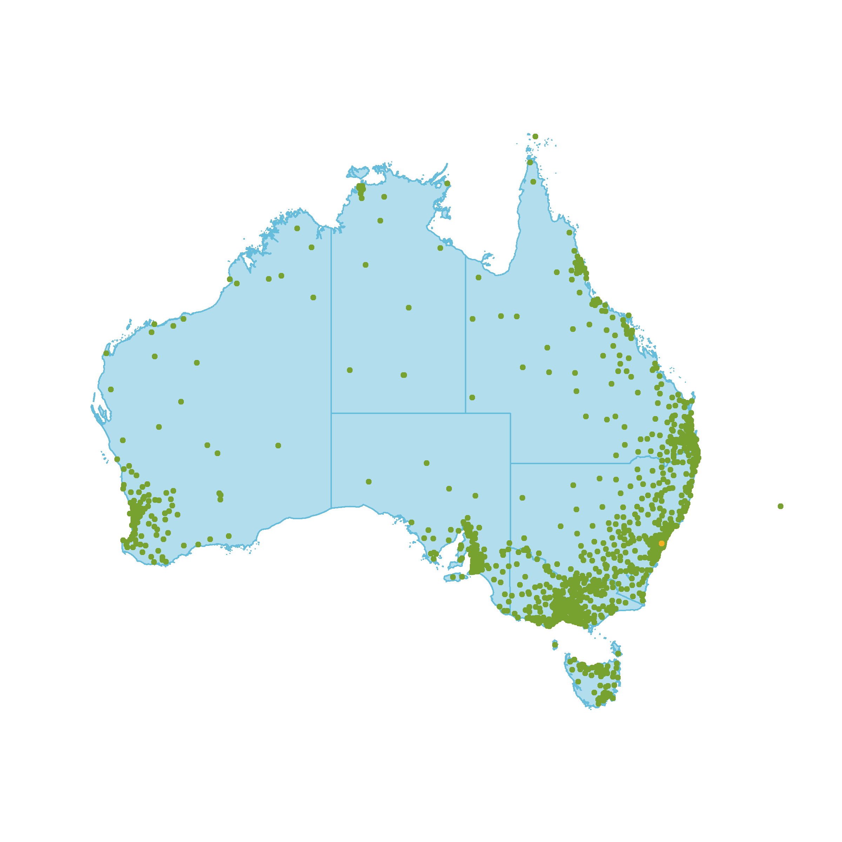
Improving mental healthcare
Consumers can access supported online treatment from anywhere in Australia
Postcode location of MindSpot consumers
Source: MindSpot (sub. 178).

Slide 28
2. Improvements beyond the health system…
… what problems are we addressing?
Numerous gateways by which people can present in need of mental healthcare, but few provide a pathway
Psychosocial supports can be critical for social inclusion, but ongoing provision can be very tenuous
Chronic underinvestment in stable housing options, with 16% people with mental illness either homeless or living in overcrowded or substandard accommodation
Too many people returning to hospital inpatient facilities and correctional facilities because of lack of stable housing in their community
People facing involuntary treatment often lack legal representation
Reform area 2

Slide 29
2. Improvements beyond the health system
Start now
Start later
Govts to commit to no discharges from care into homelessness
Additional supported housing places for people needing care on a regular basis
Work toward meeting the gap in long term housing for people with mental illness who are persistently homeless
Standards of care in correctional facilities to be equivalent to care in community
Ensure culturally capable mental healthcare for Aboriginal and Torres Strait Islanders in correctional facilities
Funding cycles for all psychosocial services to be at least 5 years
Improve eligibility requirements, availability & suitability of psychosocial supports
Mental health training and expanded tenancy support services for frontline housing tenancy workers
Develop disability justice strategies to ensure rights of people with psychosocial disabilities are protected during their interactions with justice system
Improve rigor of mental health screening in correctional facilities and actively plan for care continuity post-release
Ensure legal representation & non-legal advocacy services for those subject to involuntary mental healthcare
Recommendations

Slide 30
2. Improvements beyond the health system
Start now
Start later
Govts to commit to no discharges from care into homelessness
Additional supported housing places for people needing care on a regular basis
Work toward meeting the gap in long term housing for people with mental illness who are persistently homeless
Standards of care in correctional facilities to be equivalent to care in community
Ensure culturally capable mental healthcare for Aboriginal and Torres Strait Islanders in correctional facilities
Funding cycles for all psychosocial services to be at least 5 years
Improve eligibility requirements, availability & suitability of psychosocial supports
Mental health training and expanded tenancy support services for frontline housing tenancy workers
Develop disability justice strategies to ensure rights of people with psychosocial disabilities are protected during their interactions with justice system
Improve rigor of mental health screening in correctional facilities and actively plan for care continuity post-release
Ensure legal representation & non-legal advocacy services for those subject to involuntary mental healthcare
Recommendations

Slide 31
2. Improvements beyond the health system
Start now
Start later
Govts to commit to no discharges from care into homelessness
Additional supported housing places for people needing care on a regular basis
Work toward meeting the gap in long term housing for people with mental illness who are persistently homeless
Standards of care in correctional facilities to be equivalent to care in community
Ensure culturally capable mental healthcare for Aboriginal and Torres Strait Islanders in correctional facilities
Funding cycles for all psychosocial services to be at least 5 years
Improve eligibility requirements, availability & suitability of psychosocial supports
Mental health training and expanded tenancy support services for frontline housing tenancy workers
Develop disability justice strategies to ensure rights of people with psychosocial disabilities are protected during their interactions with justice system
Improve rigor of mental health screening in correctional facilities and actively plan for care continuity post-release
Ensure legal representation & non-legal advocacy services for those subject to involuntary mental healthcare
Recommendations

Slide 32
Gap in supported housing places across Australia
Number of places per 100 000 population
Notes:
As at 30 June 2017

Slide 33
2. Improvements beyond the health system
Start now
Start later
Govts to commit to no discharges from care into homelessness
Additional supported housing places for people needing care on a regular basis
Work toward meeting the gap in long term housing for people with mental illness who are persistently homeless
Standards of care in correctional facilities to be equivalent to care in community
Ensure culturally capable mental healthcare for Aboriginal and Torres Strait Islanders in correctional facilities
Funding cycles for all psychosocial services to be at least 5 years
Improve eligibility requirements, availability & suitability of psychosocial supports
Mental health training and expanded tenancy support services for frontline housing tenancy workers
Develop disability justice strategies to ensure rights of people with psychosocial disabilities are protected during their interactions with justice system
Improve rigor of mental health screening in correctional facilities and actively plan for care continuity post-release
Ensure legal representation & non-legal advocacy services for those subject to involuntary mental healthcare
Recommendations

Slide 34
2. Improvements beyond the health system
Start now
Start later
Govts to commit to no discharges from care into homelessness
Additional supported housing places for people needing care on a regular basis
Work toward meeting the gap in long term housing for people with mental illness who are persistently homeless
Standards of care in correctional facilities to be equivalent to care in community
Ensure culturally capable mental healthcare for Aboriginal and Torres Strait Islanders in correctional facilities
Funding cycles for all psychosocial services to be at least 5 years
Improve eligibility requirements, availability & suitability of psychosocial supports
Mental health training and expanded tenancy support services for frontline housing tenancy workers
Develop disability justice strategies to ensure rights of people with psychosocial disabilities are protected during their interactions with justice system
Improve rigor of mental health screening in correctional facilities and actively plan for care continuity post-release
Ensure legal representation & non-legal advocacy services for those subject to involuntary mental healthcare
Recommendations

Slide 35
2. Improvements beyond the health system
Start now
Start later
Govts to commit to no discharges from care into homelessness
Additional supported housing places for people needing care on a regular basis
Work toward meeting the gap in long term housing for people with mental illness who are persistently homeless
Standards of care in correctional facilities to be equivalent to care in community
Ensure culturally capable mental healthcare for Aboriginal and Torres Strait Islanders in correctional facilities
Funding cycles for all psychosocial services to be at least 5 years
Improve eligibility requirements, availability & suitability of psychosocial supports
Mental health training and expanded tenancy support services for frontline housing tenancy workers
Develop disability justice strategies to ensure rights of people with psychosocial disabilities are protected during their interactions with justice system
Improve rigor of mental health screening in correctional facilities and actively plan for care continuity post-release
Ensure legal representation & non-legal advocacy services for those subject to involuntary mental healthcare
Recommendations

Slide 36
3. Prevention and early intervention …
… what problems are we addressing?
Low awareness of care and supports available to help
Widespread stigma and cultural barriers to accessing mental healthcare
– especially for less common conditions
Early childhood educators and teachers observe development problems
but lack skills to respond effectively and pathways to direct families to
Countless school wellbeing programs, but what works?
Many people who attempt suicide receive no follow-up care in the vital weeks
after discharge
Numerous suicide prevention trials, but what works?
Reform area 3

Slide 37
3. Prevention and early intervention
Start now
Start later
Incorporate social & emotional wellbeing checks into existing physical development checks for 0 to 3 year olds
All schools assign a teacher to
be their mental health and wellbeing leader
COAG-developed strategic policy on social and emotional learning in the education system, including development of national standards for teacher training
Implement a new national stigma reduction strategy
Reduce stigma amongst health professionals
Follow-up people after a suicide attempt
Identify local priorities and responsibilities for suicide prevention
Indigenous organisations empowered as preferred providers of local suicide prevention activities for Aboriginal & Torres Strait Islander people
Monitor & report on progress toward universal screening
Expand parent information programs on child social & emotional development
Strengthen skills in workforces of early childhood education and care, and schools to support child social and emotional development
Use data on wellbeing of school students to build evidence base for future interventions
Evaluate best practices for
partnerships between traditional healers and mainstream mental healthcare for Aboriginal & Torres Strait Islander people
Apply lessons from suicide
prevention trials
Recommendations

Slide 38
3. Prevention and early intervention
Start now
Start later
Incorporate social & emotional wellbeing checks into existing physical development checks for 0 to 3 year olds
All schools assign a teacher to
be their mental health and wellbeing leader
COAG-developed strategic policy on social and emotional learning in the education system, including development of national standards for teacher training
Implement a new national stigma reduction strategy
Reduce stigma amongst health professionals
Follow-up people after a suicide attempt
Identify local priorities and responsibilities for suicide prevention
Indigenous organisations empowered as preferred providers of local suicide prevention activities for Aboriginal & Torres Strait Islander people
Monitor & report on progress toward universal screening
Expand parent information programs on child social & emotional development
Strengthen skills in workforces of early childhood education and care, and schools to support child social and emotional development
Use data on wellbeing of school students to build evidence base for future interventions
Evaluate best practices for
partnerships between traditional healers and mainstream mental healthcare for Aboriginal & Torres Strait Islander people
Apply lessons from suicide
prevention trials
Recommendations

Slide 39
Mental ill‑health is associated with social exclusion
Percentage of people deeply and marginally socially excluded
Notes:
Percentage of people deeply and marginally socially excluded

Slide 40
3. Prevention and early intervention
Start now
Start later
Incorporate social & emotional wellbeing checks into existing physical development checks for 0 to 3 year olds
All schools assign a teacher to
be their mental health and wellbeing leader
COAG-developed strategic policy on social and emotional learning in the education system, including development of national standards for teacher training
Implement a new national stigma reduction strategy
Reduce stigma amongst health professionals
Follow-up people after a suicide attempt
Identify local priorities and responsibilities for suicide prevention
Indigenous organisations empowered as preferred providers of local suicide prevention activities for Aboriginal & Torres Strait Islander people
Monitor & report on progress toward universal screening
Expand parent information programs on child social & emotional development
Strengthen skills in workforces of early childhood education and care, and schools to support child social and emotional development
Use data on wellbeing of school students to build evidence base for future interventions
Evaluate best practices for
partnerships between traditional healers and mainstream mental healthcare for Aboriginal & Torres Strait Islander people
Apply lessons from suicide
prevention trials
Recommendations

Slide 41
Follow-up after a suicide attempt
Total cost of suicide and non-fatal suicide attempts
$16 to $34 billion
Aftercare can prevent:
34
Suicide deaths
6,154
Suicide attempts
each year
And deliver $6 to $36
in avoided costs per dollar invested

Slide 42
3. Prevention and early intervention
Start now
Start later
Incorporate social & emotional wellbeing checks into existing physical development checks for 0 to 3 year olds
All schools assign a teacher to
be their mental health and wellbeing leader
COAG-developed strategic policy on social and emotional learning in the education system, including development of national standards for teacher training
Implement a new national stigma reduction strategy
Reduce stigma amongst health professionals
Follow-up people after a suicide attempt
Identify local priorities and responsibilities for suicide prevention
Indigenous organisations empowered as preferred providers of local suicide prevention activities for Aboriginal & Torres Strait Islander people
Monitor & report on progress toward universal screening
Expand parent information programs on child social & emotional development
Strengthen skills in workforces of early childhood education and care, and schools to support child social and emotional development
Use data on wellbeing of school students to build evidence base for future interventions
Evaluate best practices for
partnerships between traditional healers and mainstream mental healthcare for Aboriginal & Torres Strait Islander people
Apply lessons from suicide
prevention trials
Recommendations

Slide 43
3. Prevention and early intervention
Start now
Start later
Incorporate social & emotional wellbeing checks into existing physical development checks for 0 to 3 year olds
All schools assign a teacher to
be their mental health and wellbeing leader
COAG-developed strategic policy on social and emotional learning in the education system, including development of national standards for teacher training
Implement a new national stigma reduction strategy
Reduce stigma amongst health professionals
Follow-up people after a suicide attempt
Identify local priorities and responsibilities for suicide prevention
Indigenous organisations empowered as preferred providers of local suicide prevention activities for Aboriginal & Torres Strait Islander people
Monitor & report on progress toward universal screening
Expand parent information programs on child social & emotional development
Strengthen skills in workforces of early childhood education and care, and schools to support child social and emotional development
Use data on wellbeing of school students to build evidence base for future interventions
Evaluate best practices for
partnerships between traditional healers and mainstream mental healthcare for Aboriginal & Torres Strait Islander people
Apply lessons from suicide
prevention trials
Recommendations

Slide 44
4. Increasing attachment to education and work …
… what problems are we addressing?
Educational adjustments in schools for psychological disabilities are a legal requirement but can be hard to access
Teenagers and young adults who disengage from education or work have reduced wellbeing and income prospects
Employment services are not adequately tailored to the circumstances and capabilities of job seekers with mental illness
Psychological hazards have received inadequate attention in workplace health and safety
Delays in treatment for people who have work-related mental illness significantly adds to the cost of mental illness for the individual, workplace, and community
Reform area 4

Slide 45
4. Increasing attachment to education and employment
Start now
Start later
Effective outreach for disengaged school students
Tertiary education institution registration linked to having effective student mental health & wellbeing strategy
Improve employment support program assessment tools for people with mental illness
Increase the appropriateness of job plans for those people with mental illness who are using employment services
Amend model WHS laws to elevate the importance of psychological health & safety
Develop codes of practice to assist employers to better manage psychological risks in their workplace
Provision of no-liability clinical treatment for mental health related workers compensation claims
Review insurance industry practices for people with mental illness
Staged rollout of Individual Placement & Support programs to job seekers with mental illness
Eligibility criteria for Carer Payment and Carer Allowance that account for the differences between mental and physical illness
WHS agencies to work with employers to collect & disseminate information on effectiveness of workplace programs & interventions
Recommendations

Slide 46
4. Increasing attachment to education and employment
Start now
Start later
Effective outreach for disengaged school students
Tertiary education institution registration linked to having effective student mental health & wellbeing strategy
Improve employment support program assessment tools for people with mental illness
Increase the appropriateness of job plans for those people with mental illness who are using employment services
Amend model WHS laws to elevate the importance of psychological health & safety
Develop codes of practice to assist employers to better manage psychological risks in their workplace
Provision of no-liability clinical treatment for mental health related workers compensation claims
Review insurance industry practices for people with mental illness
Staged rollout of Individual Placement & Support programs to job seekers with mental illness
Eligibility criteria for Carer Payment and Carer Allowance that account for the differences between mental and physical illness
WHS agencies to work with employers to collect & disseminate information on effectiveness of workplace programs & interventions
Recommendations

Slide 47
5. Governance and funding …
… what problems are we addressing?
The programs and measures that Governments choose to fund seems ad hoc, fragmented, uncoordinated, duplicative in some regions, creating poor incentives for providers in others
Lack of national coordination and consistency on measures to achieve desired outcomes
A lot of data is collected but little information is derived and used – this limits incentives for providers to improve their services; and inhibits use of data by consumers and carers to make decisions about treatment and support options
What interventions are outcome-effective and cost-effective remains a mystery in many areas
Reform area 5

Slide 48
5. Reforming funding and governance
Start now
Start later
Include consumers and carers in all mental health program development
COAG to develop a new National Mental Health & Suicide Prevention Agreement that
establishes clear funding, data sharing and service delivery responsibilities
creates RCA governance arrangements (if adopted)
Expedite National Strategic Framework for Aboriginal & Torres Strait Islander Peoples’ Mental Health & Social & Emotional Wellbeing
Determine targets for key outcomes, & set data collection, monitoring & evaluation arrangements consistent with targets
COAG to develop new whole-of-govt strategy to align health and non-health sectors on improving mental health outcomes
Review regulations preventing insurers from funding community mental health care
Review proposed activity-based funding classification for mental healthcare
Link regional mental health funding to volume of regional MBS rebates for allied mental healthcare
NMHC to be given statutory authority
Strengthen national leadership, guidance and the coordination of mental health program evaluations and research
Use data collections to evaluate what works well, encourage continuous improvement and inform funding decisions and consumer choices
Responsibility for all (non-NDIS) psychosocial & carer supports to be with states and territories
Recommendations

Slide 49
5. Reforming funding and governance
Start now
Start later
Include consumers and carers in all mental health program development
COAG to develop a new National Mental Health & Suicide Prevention Agreement that
establishes clear funding, data sharing and service delivery responsibilities
creates RCA governance arrangements (if adopted)
Expedite National Strategic Framework for Aboriginal & Torres Strait Islander Peoples’ Mental Health & Social & Emotional Wellbeing
Determine targets for key outcomes, & set data collection, monitoring & evaluation arrangements consistent with targets
COAG to develop new whole-of-govt strategy to align health and non-health sectors on improving mental health outcomes
Review regulations preventing insurers from funding community mental health care
Review proposed activity-based funding classification for mental healthcare
Link regional mental health funding to volume of regional MBS rebates for allied mental healthcare
NMHC to be given statutory authority
Strengthen national leadership, guidance and the coordination of mental health program evaluations and research
Use data collections to evaluate what works well, encourage continuous improvement and inform funding decisions and consumer choices
Responsibility for all (non-NDIS) psychosocial & carer supports to be with states and territories
Recommendations

Slide 50
Benefits of reforms
$8.8 to $11.5 billion
Long-run economic benefits of key reforms
Including: $4.3 to $5.6 billion
Improved social and emotional learning in early childhood and school education
$1.3 to $1.8 billion
Stigma reduction
$1.4 to $1.8 billion
Additional psychosocial supports
$1.1 to $1.5 billion
Additional community ambulatory mental health services

Slide 51
Timeline
31 Oct 2019
Draft Report
Draft
23 May 2020
Final Report to Government
7 Oct 2018
Jan 2019
Government announces inquiry
23 Nov 2018
PC releases issues paper
5 April 2019
23 Jan 2020
Treasurer sends reference to Commission
Initial submissions due
Final submissions due
PC visits interested parties, invites submissions & comments
Nov 2019 to Feb 2020
Public hearings and further consultation
Process

Slide 52


